Slide 1
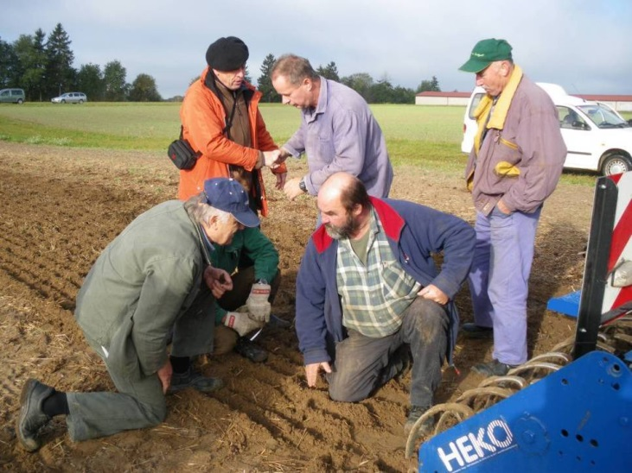
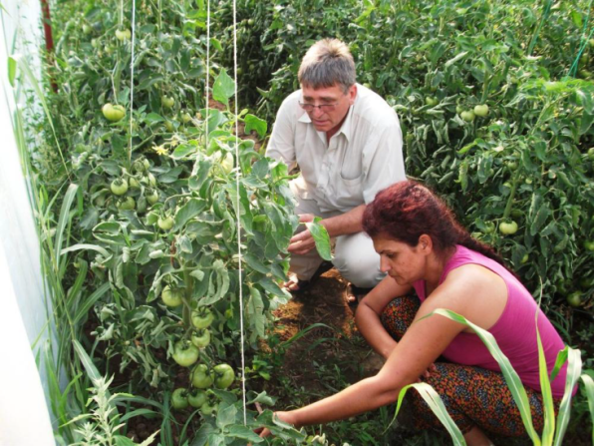

Advisory services
in the
European AKIS
Introduction and Overview
Brussels, May 19, 2015
Andrea Knierim

Slide 2
Structure
  The PRO AKIS project
  Overview of outputs
  The inventory: AKIS and advisory services
  The involvement of stakeholders
  Observations and conclusions
Structure
Notes:
Alexandra: Dieses Layout würde mir am besten gefallen: oben grüner Titel und Strich, Text in der Mitte in Schwarz und ggf. Überschriften in grün; Unten links logo, dann Kapiteltitel oder Schlagwort; die Seitenzahl kann auch mittig sein und rechts, unauffällig, das Hohenheim logo; wenn das nicht gut zu realisieren ist, dann geht auch das master von Folie 4, aber wiederum gern mit grünem Titel und mit Hohenheim logo
Schrift einheitlich – tahoma, aber in der Größe durchaus variabel (nicht tahoma)

Slide 3
Some background information
Title: Prospects for farmers’ support: advisory services in the European AKIS
The project
  EU FP 7 – CSA, 1.5 Mio €
  8 partners from 7 countries: INRA, JHI, SEGES, UAK, UAP, UHOH, UTAD, ZALF
  30 months, 2012/12 – 2015/5
  Overall goal:
      Contribute to the performance of advisory services within the European AKISs to provide relevant and reliable knowledge for farmers and other rural actors
Background information

Slide 4
The political background
Agricultural advisory services enforced by EU policies:
Regulations EC 1782/2003 and 73/2009 on CC
  Farm advisory services to support farmers’ compliance (and more)
  Regulations EC 1689/2005 and 1305/2013 on RD
      the use of advisory services
      Setting up of management, relief and advisory services
      Knowledge transfer and information actions
      … ensure the availability of sufficient advisory capacity ..
Background information

Slide 5
How do we understand ‘AKIS’?
Agricultural knowledge and information/innovation system (AKIS) according to PRO AKIS
an AKIS concept that aims at describing knowledge infrastructure (Klerkx et al. 2012)
it gives a central role to the analysis of agricultural advisory services (Assefa et al. 2009)
it aims at better understanding knowledge flows within the system, focussing on the issue of knowledge access for a diversity of actors (Hall et al. 2006)
it works at a scale (mostly national or regional) that matches the aim of describing the situations in the EU member states
(Labarthe et al. 2013)
AKIS concepts
Notes:
Agricultural knowledge and information system (AKIS) indicates a system that links people and institutions to promote mutual learning and generate, share, and utilize agriculture related technology, knowledge, and information. The system integrates farmers, agricultural educators, researchers, and extensionists to harness knowledge and information from various sources for improved livelihoods. Farmers are at the heart of this knowledge triangle.
Agricultural innovation system (AIS) indicates a network of organizations, enterprises, and individuals focused on bringing new products, new processes, and new forms of organization into economic use, together with the institutions and policies that affect their behaviour and performance

Slide 6
How do we understand
‘Advisory Services’?
Agricultural advisory services
… as the entire set of organisations that will enable farmers to co-produce farm-level solutions by establishing service relationships with advisers to produce knowledge and enhance skills …
A clear understanding of the activity providing infrastructures, but not a normative view about the aim, governance, funding and methods of these services…
AKIS concepts
(Labarthe et al. 2013)
Notes:
Background info for Marianne

Slide 7
PRO AKIS activities and outputs
Conceptual framework for the assessment of AKIS
Inventory of the AKIS institutions and interactions in the EU-27, consisting of national reports and a searchable database
Comparative Analyses of challenges for European AKIS through 12 case studies
Policy recommendations for European AKIS
Aim of the inventory: create an overview on advisory systems in the EU given their recent political attention and the drastic institutional changes they undergo
PRO AKIS outputs

Slide 8
Expected impacts
Raising of awareness for AKIS in EU-27
Recommendations on ‘how to strengthen (F)AS’
Enrich discussion about networks and operational groups in the EIP
Support for social cohesion in rural areas through information on knowledge flows among different types of farms
Tested methods for structured AKIS stakeholder involvement
PRO AKIS outputs
8

Slide 9
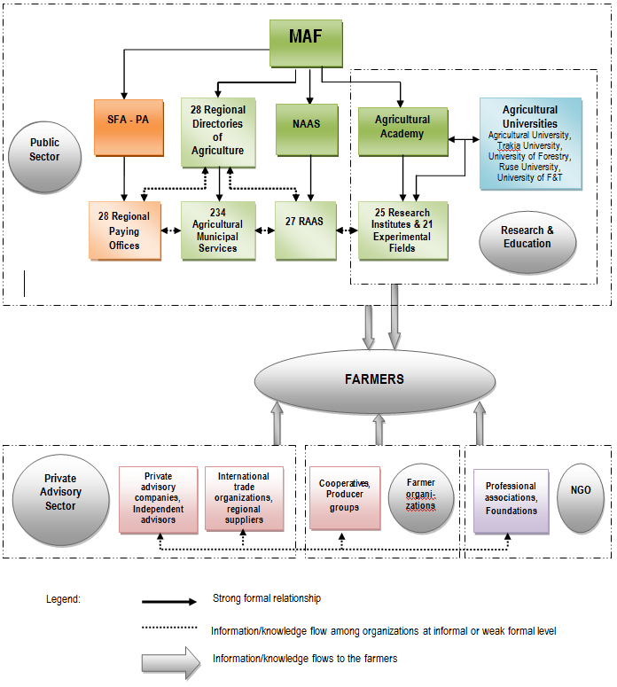
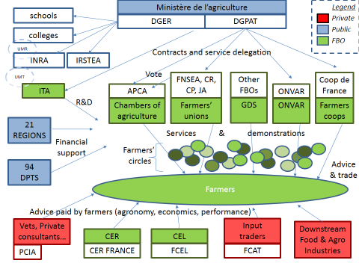
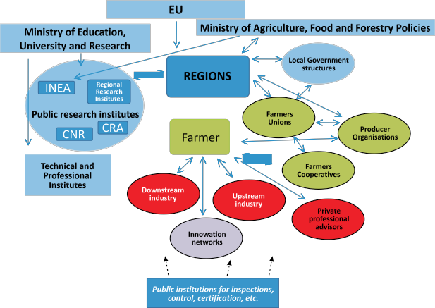
The Diversity of European AKIS
- a visual appraisal
Bulgaria
France
Greece
AKIS in Europe: the inventory
Notes:
Muss noch ergänzt werden

Slide 10
Positioning of European AKISs
- an attempt of systematisation
The position of the national AKIS in the matrix was constructed according to its qualitative characteristics in the inventory:
(1) strong vs weak and (2) fragemented vs integrated
(1) Strong vs weak
dominant institutional actors existing
availability of (public) means for AKIS
Farmers being reached by advice
AKIS in Europe: the inventory
10

Slide 11
Positioning of European AKIS in a two dimension matrix
(2) Fragmented vs integrated:
Coordinating structure(s) existing
National AKIS and/or advisory services policies
Linkages between various actors
positively or negatively rated
AKIS in Europe: the inventory
11

Slide 12
Examples for selected
AKIS characteristics
Weak vs Strong
Fragmented vs Integrated
Greece, Portugal: no or few funds for public advisory services; unclear whether farmers are reached
Cyprus: pressure for the restructuring/downsizing of public support
Austria, Ireland: widespread public support
France, Germany: dedicated resources, powerful actors
Greece, Portugal, Romania: weak or no linkages between different actors
UK: complex open system that follows the laissez-faire model
Austria: public research, education and extension bodies well connected
Ireland: linkages and coordination between public and private actors exists
AKIS in Europe: the inventory

Slide 13
Results and conclusions from AKIS inventory
Great diversity of AKIS (in Europe)
  Comparative appraisal not useful because of the multitude of influencing factors;
  Functional focus is appropriate to support comparison and mutual learning
The conceptual value of AKIS is high
  Gives an overview and supports analysis of vertical and horizontal interaction and integration
Attention:
  AKIS concept wasn‘t well known in the Member States in 2013
  Education wasn‘t explicitly addressed – although an important component in many Member States
Knierim et al. 2015
AKIS in Europe: the inventory
Notes:
There is no easy aggregation or comparative view possible

Slide 14
Dominant advisory services (in 2013)
Type of dominant advisory service org | Country
Public | Bulgaria Greece Hungary* Ireland Latvia* Poland* Romania* Slovakia*
Private | Estonia* The Netherlands
Farmer-Based Organisation | Austria* Belgium Cyprus Denmark Finland France* Lithuania* Portugal Slovenia* Spain Sweden
Public/ Private | Czech Republic* United Kingdom
Public/Private/FBO | Germany* Italy Malta
Public/ FBO | Luxembourg*
Advisory Services
Notes:
Here, dominant is meant in terms of the providers not much about financiation - Public means by public administration
Private can be private for profit as it is the case in NL or private non-profit – as it is the case in Estonia
We use it the way it emerged from the reports
Interesting is again a) the diversity and b) the strong role that is obviously played by farmer-based organisations;
Is there evidence that when farmer-based organisations are involved then the overall AKIS is stronger and / or better integrated than in e.g. publically dominated ones?

Slide 15
The major target groups by dominant type of advisory service organisation
Type of advisory organisation | Type of target group (by rank / hierarchy)
Public | Medium commercial farms; Small commercial farms; Young farmers;
Private (private profit companies, individual consultants) | Large commercial farms; Medium commercial farms; Small commercial farms;
FBOs (chambers of agriculture, farmers’ unions, farmers’ associations, farmers’ cooperatives) | Medium commercial farms; Large commercial farms; Small commercial farms; Producers’ groups;
Source: the country reports, 2013
Advisory Services

Slide 16
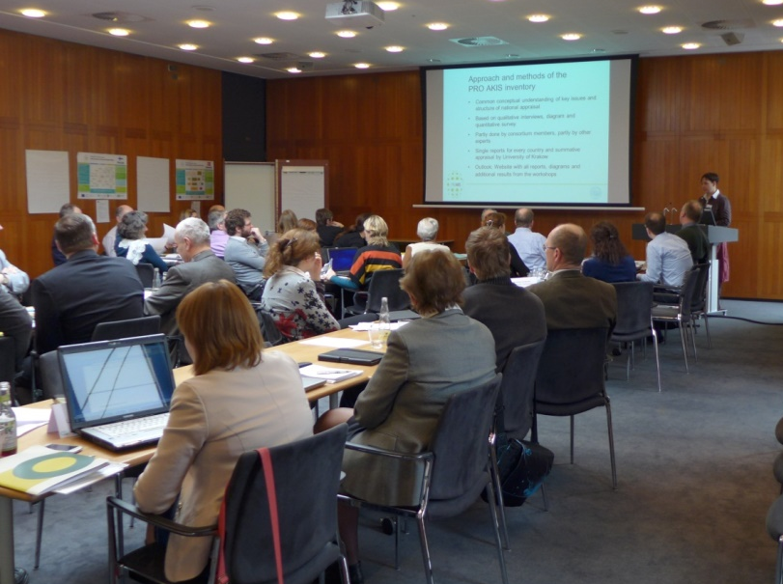
Stakeholder involvement in the AKIS analyses
3 regional workshops in Feb/March 2014:
Copenhagen on ‚northern Europe‘ with UK and Ireland, Scandinavian and Baltic Countries
Paris on ‚southern Europe‘ with Mediterranean and Eastern European Countries
Krakow on ‚central Europe‘
from East to West
Stakeholder involvement

Slide 17
Who were the stakeholders involved?
Stakeholder involvement

Slide 18
Who were the stakeholders involved?
Stakeholder involvement

Slide 19
Who were the stakeholders involved?
Stakeholder involvement

Slide 20
Findings emerging from discussions with stakeholders
New user groups in AKIS, e.g. migrants to rural areas, new small-scale farmers, young farmers – while also AKIS is broadening.
Increasing diversity in types of users, it seems that some groups are excluded from advisory services (e.g. Part-time farmers).
Increasing trend to privatisation of advisory services which potentially leads to competition –> enhancing cooperation is a critical issue.
Emerging new roles of public services in more and more pluralistic advisory systems.
Need to assess the quality of advisory services and AKIS.
Stakeholder involvement

Slide 21
Observations and conclusions
Fortunate coincidence of project and political and societal discourses – “Advisory service is back on the European agenda”.
Hugh need to exchange and discuss among institutional stakeholders to solve policy implementation challenges
-> a multi-level, multi-actor governance issue.
However, reduced resources and increasing institutional fragmentation in many countries;
-> little is known which farmers/end users are reached and
benefit from advice.
Although advice may come from FB and private organisations, public institutions remain with key functions in the AKIS
such as coordination, monitoring and quality control.

Slide 22
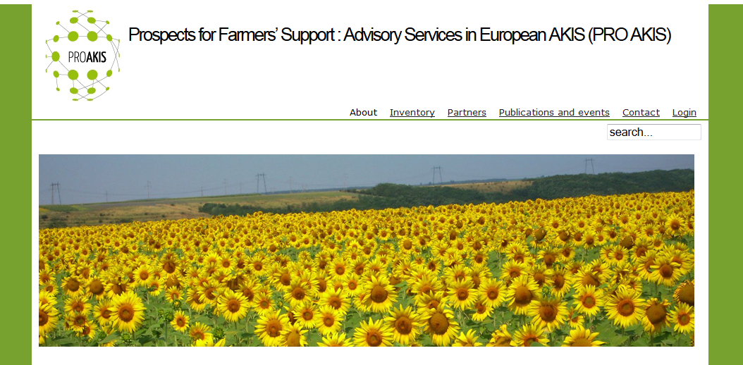
www.proakis.eu
Visit our website !
Thank you for your attention!

